Slide 1
Decision Making

Slide 2
What is Decision making?
Decision making is anticipation of conditions occuring whilw
execution of the program and specifying actions taken accoriding ot hte conditon
decision structures evaluate multiple exprssions which produce TRUE or FALSE as outcome.you need to determine which acction to take and which statments to execute if outcome is TRUE or FALSE otherwise.

Slide 3
Types of Decision making
IF
IF-ELSE
IF-ELIF-ELSE
NESTED IF
There is no switch case in python

Slide 4
IF Statements
if statement is the most simple decision making statement. It is used to decide whether a certain statement or block of statements will be executed or not i.e if a certain condition is true then a block of statement is executed otherwise not.
if condition:
statement1
statement2
# Here if the condition is true, if block
# will consider only statement1 to be inside
# its block.

Slide 5
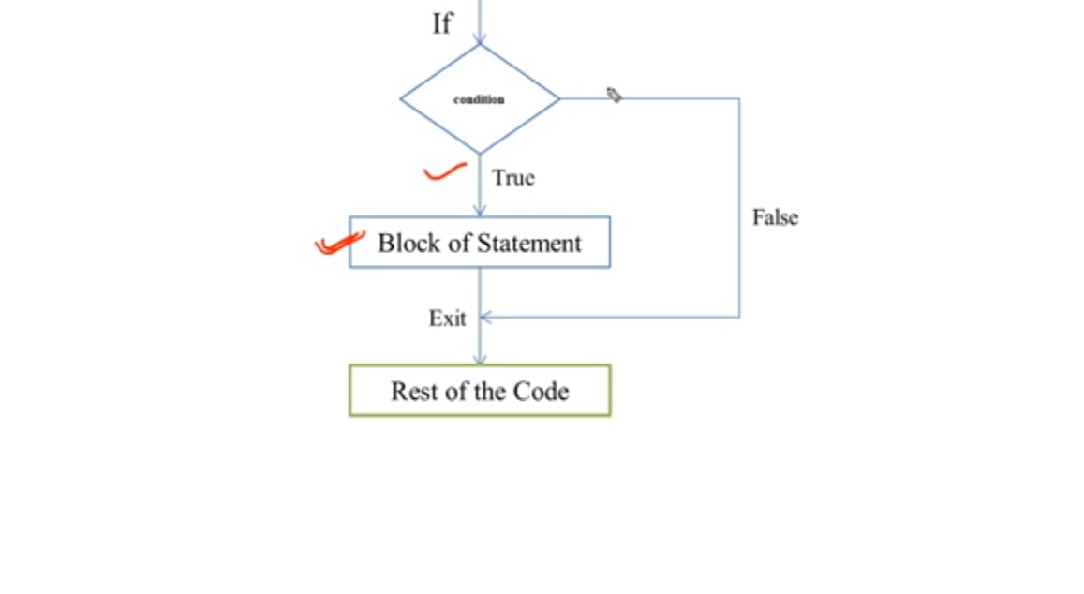
Flowchart
Start

Slide 6
Example
check the persion is eligible for the vote or not
check the the number is greater then equal to or not

Slide 7
IF else statement
The if statement alone tells us that if a condition is true it will execute a block of statements and if the condition is false it won’t. But what if we want to do something else if the condition is false. Here comes the else statement. We can use the else statement with if statement to execute a block of code when the condition is false
if (condition):
# Executes this block if
# condition is true
else:
# Executes this block if
# condition is false

Slide 8
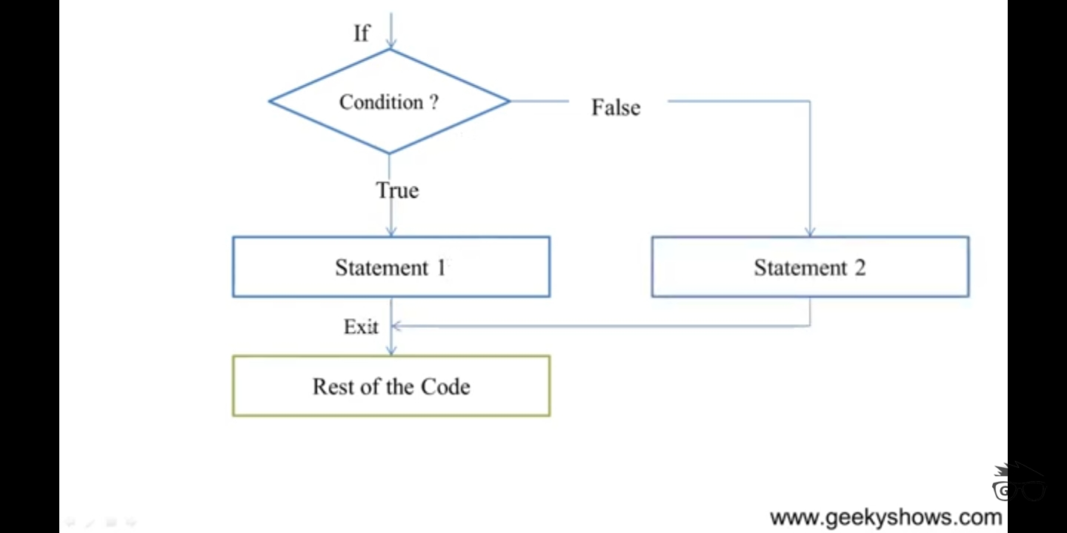
Flowchart
Start

Slide 9
Example
i = 50;
if (i < 25):
print ("i is smaller than 25")
print ("i'm in if Block")
else:
print ("i is greater than 25")
print ("i'm in else Block")
print ("i'm not in if and not in else Block")

Slide 10
IF-ELIF-ELSE
Here, a user can decide among multiple options. The if statements are executed from the top down. As soon as one of the conditions controlling the if is true, the statement associated with that if is executed, and the rest of the ladder is bypassed. If none of the conditions is true, then the final else statement will be executed.
if (condition):
statement
elif (condition):
statement
.
.
else:
statement

Slide 11
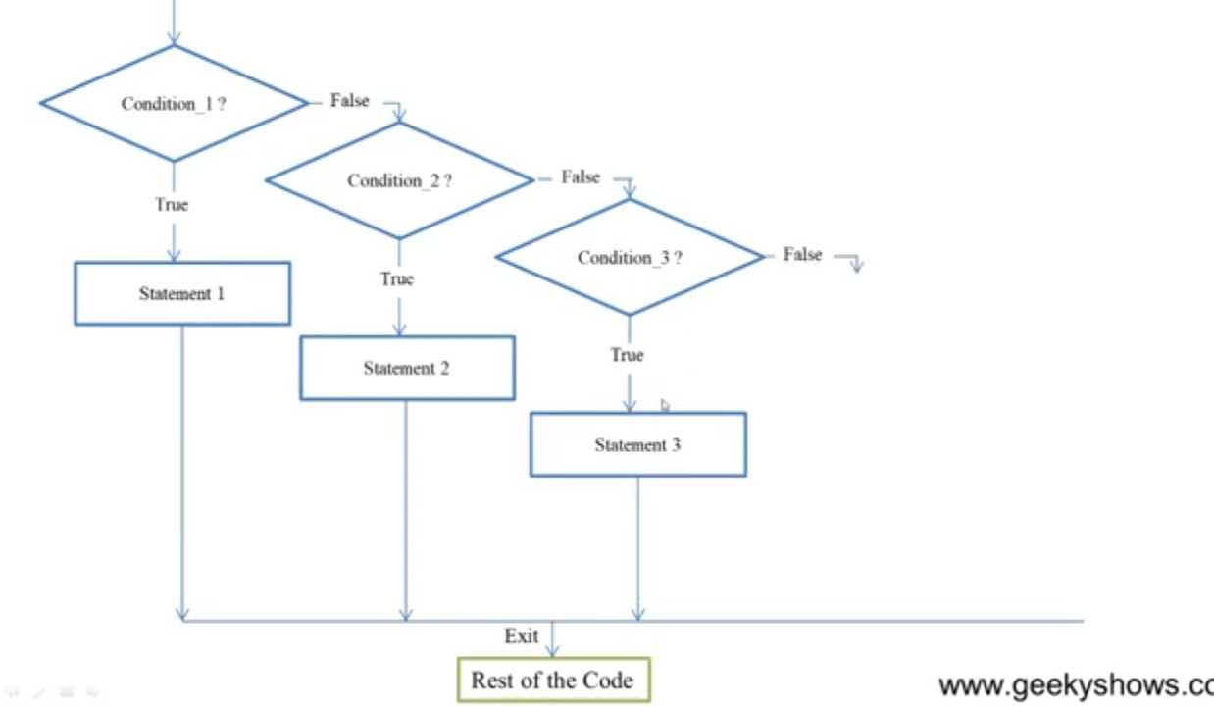
Flow chart

Slide 12
Example
a = 10
b =20
if (a>b):
print("a is grater then b")
elif a==b:
print("a is equal to b ")
elif a<b:
print("a is less then b")
else:
print("no values match")

Slide 13
Nested if Statment
Python Nested If Statement means to place one If Statement inside another If Statement. Python If Else statement allows us to print different statements depending upon the expression result (TRUE, FALSE). Sometimes we have to check further even when the condition is TRUE. In these situations, we can use the Python Nested IF statements, but be careful while using it.

Slide 14
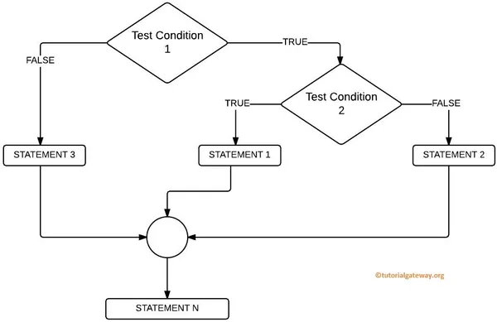
Flowchart
If the Test Condition1 is FALSE, then STATEMENT3 executed. If Test Condition1 is TRUE, it checks for the Test Condition2, and if it is TRUE, then STATEMENT1 executed else STATEMENT2

Slide 15
Example
i = 13
if (i == 13):
# First if statement
if (i < 15):
print ("i is smaller than 15")
if (i < 12):
print ("i is smaller than 12 too")
else:
print ("i is greater than 12 and smaller than 15")

Slide 16
rollno = int(input("enter roll number :"))
name = input("enter the name: ")
gender = input("enter the gender: ")
standard = int(input("inter hte class: "))
english = int(input("enter the englis: "))
physic = int(input("enter the physic: "))
chemistry = int(input("enter the chemistery: "))
hindi = int(input("enter the hindi: "))
santricket = int(input("enter the santricket: "))
obtained_mark = english+physic+chemistry+hindi+santricket
print(obtained_mark)
percentae = obtained_mark /500*100
print(percentae)
print("------------print the stuent marksheet-----------")
print("your roll number: " + str(rollno))
print("your name :"+name)
print("your gender: "+gender)
print("your class :"+str(standard))
print("print total mark are: 500")
print("otained marks are: "+str(obtained_mark))
print("your presentage is :"+ str(precentage))
if percentae>= 80:
print("grade: A-1")
elif percentae >=70:
print("grade: A")
elif percentae >=60:
print("grade: B")
elif percentae >= 50:
print("grade: C")
elif percentae >=40:
print("grade :D")
elif percentae >=30:
print("grade: E")
else:
print("fail")
#count the subject fail
i = 0
if english <30:
i+i+1
if physic<30:
i=i+1
if chemistry<30:
i=i+1
if hindi <30:
i=i+1
if santricket <30:
i=i+1
print("failed subject count: "+ str(i))

Slide 17
calculator
print("welcome to my calculator: ")
num = input("please enter your + , - , / , * :")
print("you have selected ",num)
deep1 =int(input ("enter the first number :"))
deep2 = int(input("enter the second number :"))
if num == '+':
print("your answer :", deep1+deep2)
elif num =='-':
print("your anser :",dee1-deep2)
elif num =='/':
print("your anser :",dee1/deep2)
elif num =='*':
print("your anser :",dee1*deep2)
else:
print("something is wrong:")

Slide 18
enter basic salary of employee and claculate net salary HRA = 3 , TA =2
value = eval(input(“enter the salary:))
hra = value*2/100
a = value+hra+ta
print(“net salary is :”,value)

Slide 19
enter the basic salary of employee and calculate net salary if basic salary grater than 5000 then give hra 3% ,ta 2% , if absic salary is less than 5000 then give hra 2% and ta =4%
value =eval(input(“enter the salary))
if value > 500:
hra =value*3/100
ta = value*2/100
if value <= 5000:
hra = value*2/100
ta =value*4/100
print(“net salary is :”,value)

Slide 20
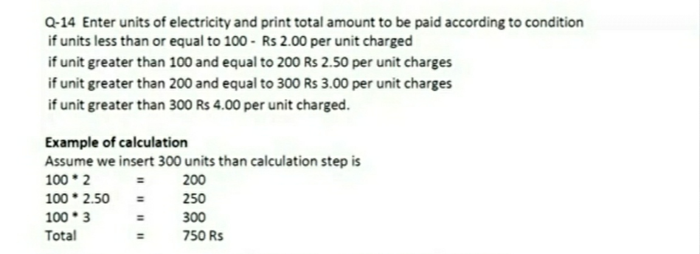

Slide 21
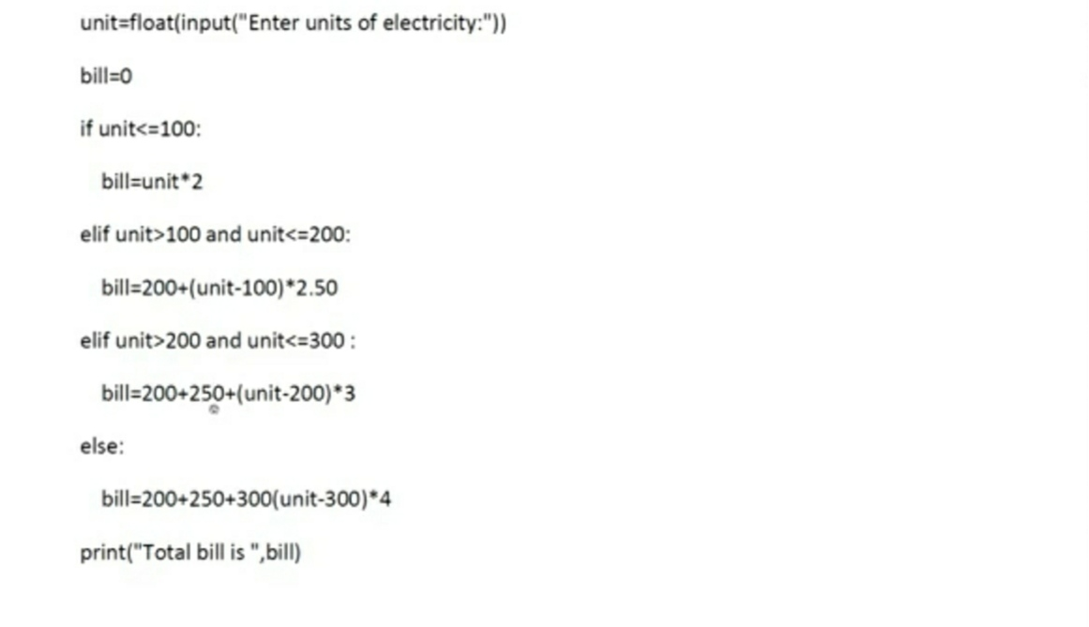
solution

Slide 22
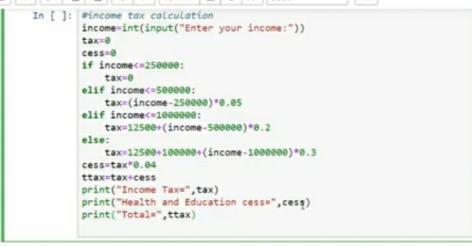
write the program to calculate income tax

Slide 23
#write a program to calculate tax and gst
cost = float(input("entet the cost of the product :"))
gst = float(input("enter the precentage charge of gst :"))
gst_cal = cost*gst/100
amount =cost+gst_cal
print("gst is ...",gst)
print("amount to pay is ...",amount)
income = float(input("enter the annual inocme"))
if income <200000:
tax =0
elif income < 400000:
tax=(income-200000)*0.05
elif income<800000:
tax=(income-400000)*0.07+10000
else:
tax=(income-800000)*0.1+38000
print("income tax to pay =",tax)

Slide 24
write a program to print max number and min

Slide 25
write to find largest and smallest number

